Slide 1

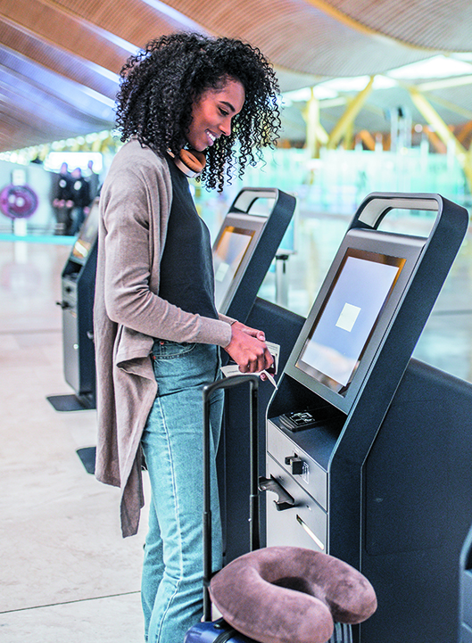



Newland-id.com

Slide 2
Fujian Newland Computer Co. Ltd.
Public company Shenzhen Stock Exchange
Ticker 00997.
After 20 years of fast growth, Newland has become
a famous IT top 500 High-Tech and top 100 Software Enterprise in China with the net assets of
USD 2.5 Billion and more than 5000 employees.
The group’s principal activities are the manufacturing, selling and leasing of computers and peripheral equipment. Provisions of computer technology, information services and designing, installing and testing of computerized highway tolls, monitors and systems.
Corporate HQ
Fuzhou, Fujian Province, China
China domestic operations
13 regional offices all across China
Newland EMEA
Culemborg, The Netherlands
Newland North America Inc.
Fremont, CA, US
Taiwan Newland Co. Ltd.
Taipei, Taiwan

Slide 3
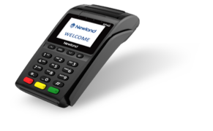
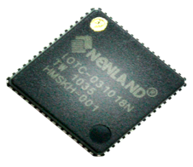
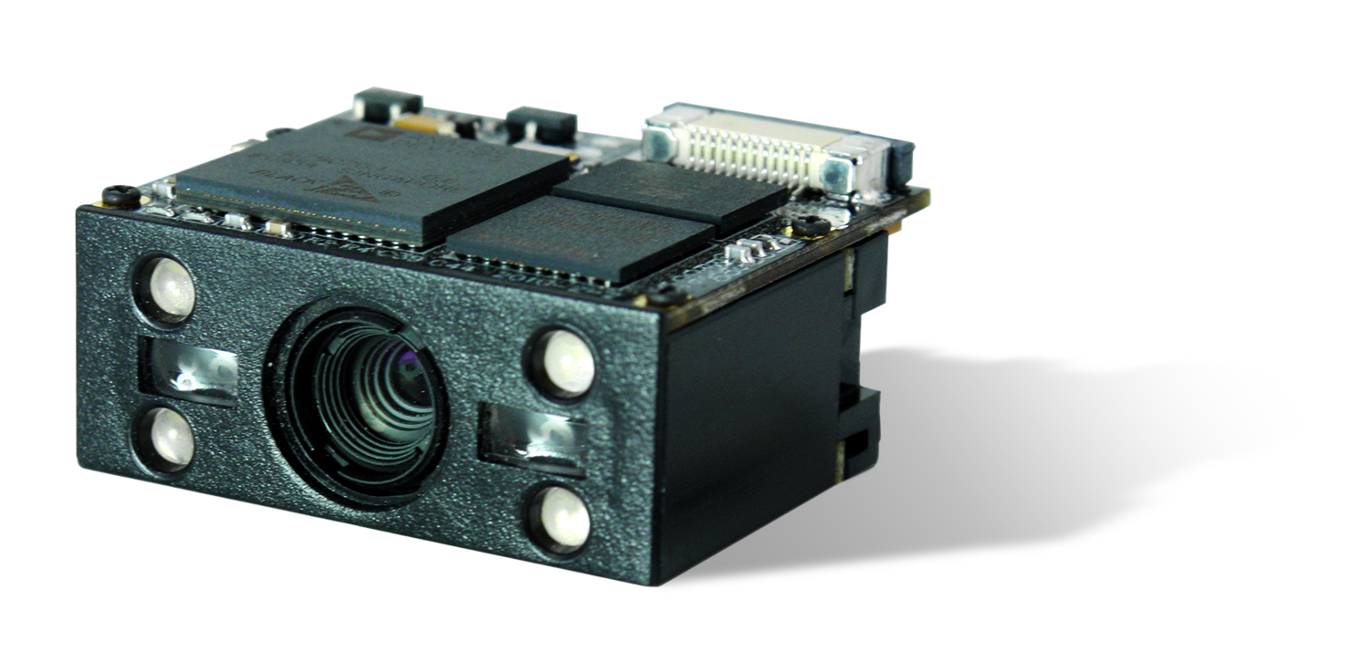
Major achievements
Decoding Chip
First 2D barcode chip in the world.
First 1D barcode chip in China.
Scan Engine
Shipment ranking № 1 in China.
№ 3 OEM manufacturer in the world.
№ 4 in AIDC business in the world.
EFP POS Terminal
№ 3 of market share in the world.
500+ products and technologies of independent intellectual property rights.
450 national patents and 13 international patents.

Slide 4
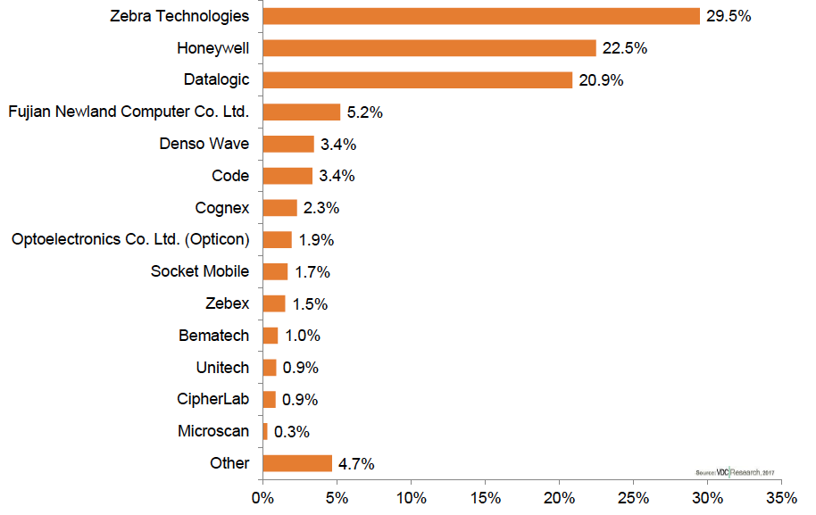
Major achievements
Number 4 Global Vendor of Handheld Barcode Scanners.
According to VDC report 2017, Newland is the
4th Global Vendor of Handheld Barcode Scanners in the world (percentage of dollars).

Slide 5
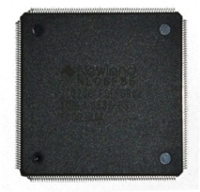
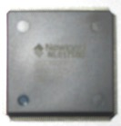
Major achievements
Our Core Competence: System on a Chip (SOC)
TSOC is the first domestic SOC chip which is customized according to the application, characteristics of financial terminals in both the Chinese and the Western language, and also firstly achieves automation.
Microprocessor chip NL06F86 is specially designed for POS, tax controller, and terminal products. This SOC integrates a 32-bits RISC CPU, as well as the digital part of peripheral hardware module (such as magnetic card, IC card, Ethernet and Display) which is normally used in tax control terminals. The hardware circuit of tax control terminals is based on the SOC scheme and consists solely of SOC, storage chip and peripheral analog interface.
Newlands leading SOC technology simplifies the hardware design of tax control terminals, the design of software driver and the manufacturing technology. It improves the products’ reliability, readability and maintainability. Meanwhile the cost price of such equipment is dramatically reduced and the performance of products is strongly improved.

Slide 6


Newland global
service network
EMEA
Beijing
NORTH
AMERICA
Shanghai
Wuhan
FUZHOU
Chengdu
TAIWAN
Guangzhou

Slide 7
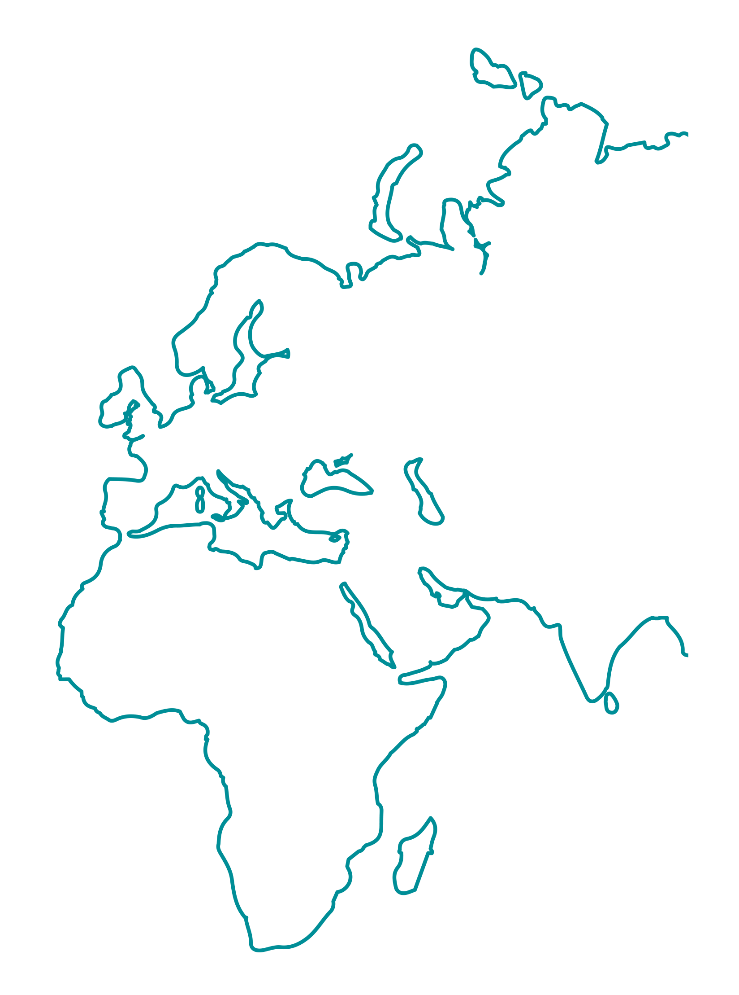
Newland EMEA (Newland Europe BV)
Newland Europe BV was founded in January 2009 in the Netherlands. We are dedicated to the deployment and development of the core technology of our parent group in the European, Middle Eastern and African (EMEA) region.
We commit ourselves to producing advanced AIDC (Automatic Identification and Data Capture) technology
and providing high quality products to a wide international market at a fair price.
In accomplishing this solution driven approach, flexible and responsive customer relations are of invaluable strategic importance to us. Newland’s regional branch offices and partners are committed to serving customer demands in the best possible way on a daily basis.
EMEA

Slide 8
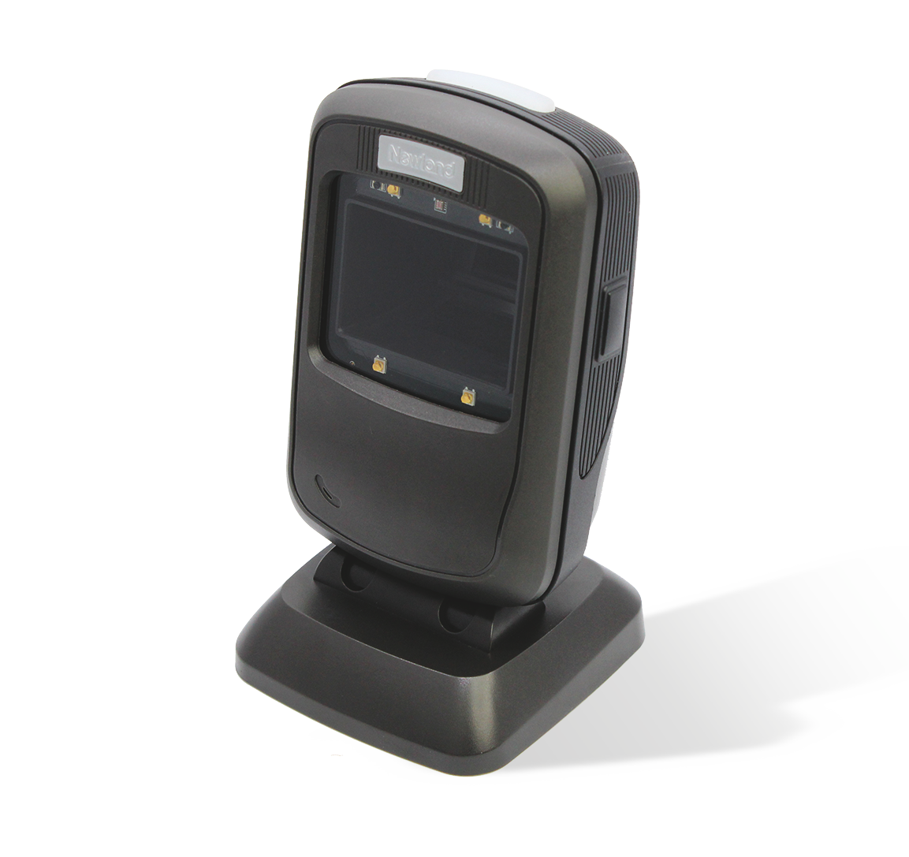
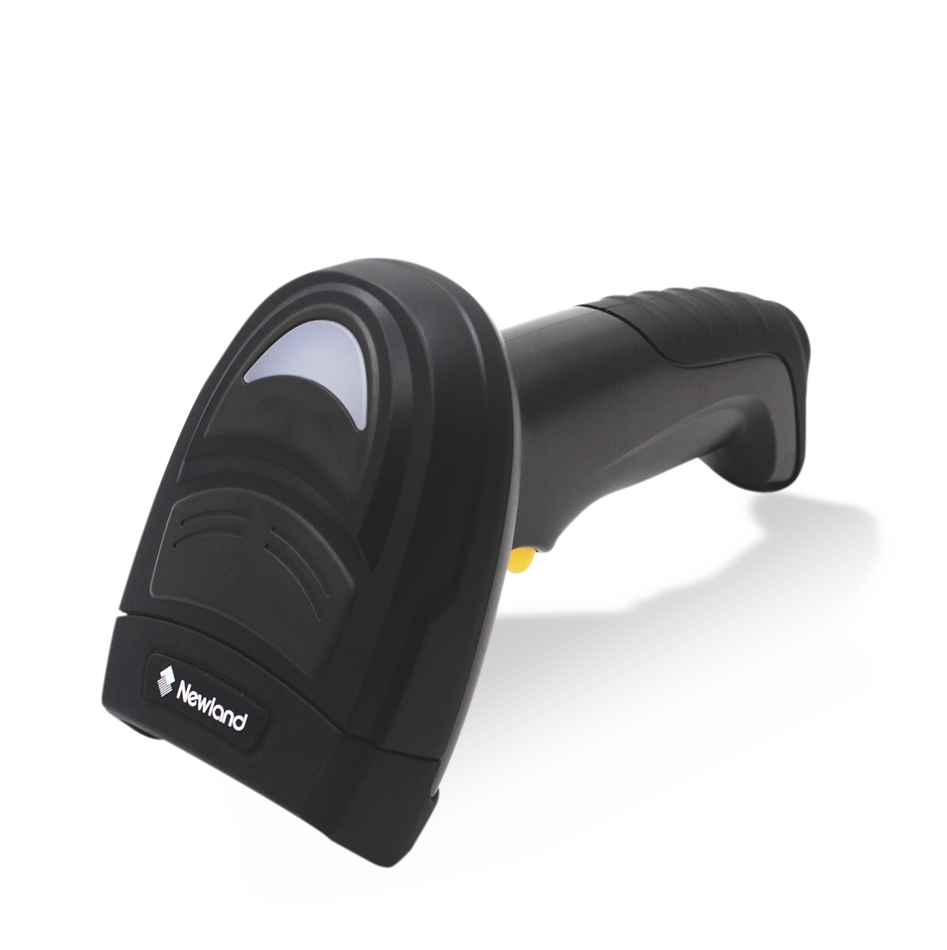
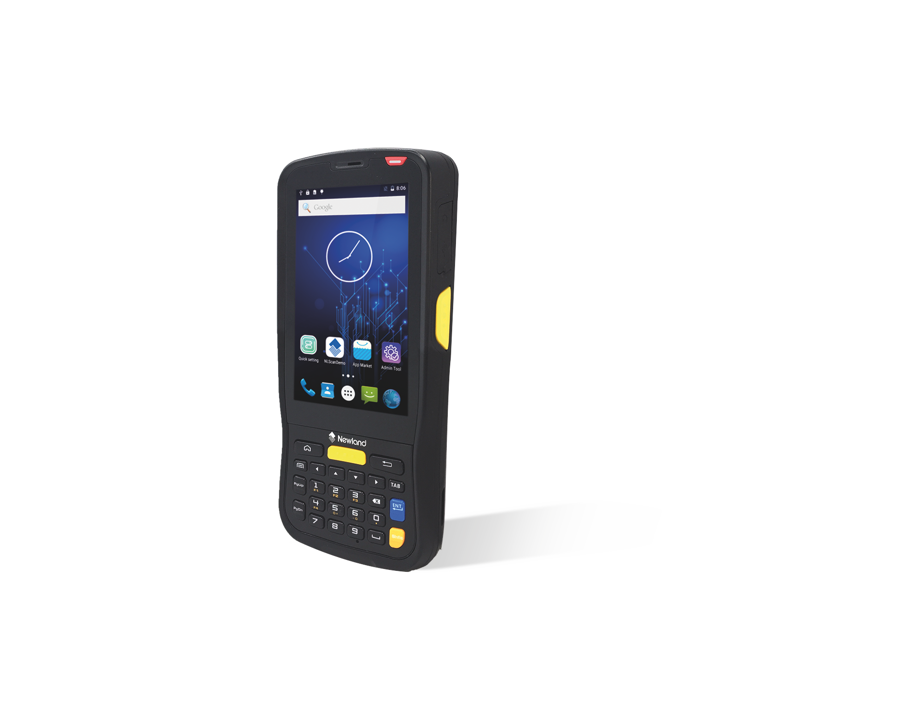
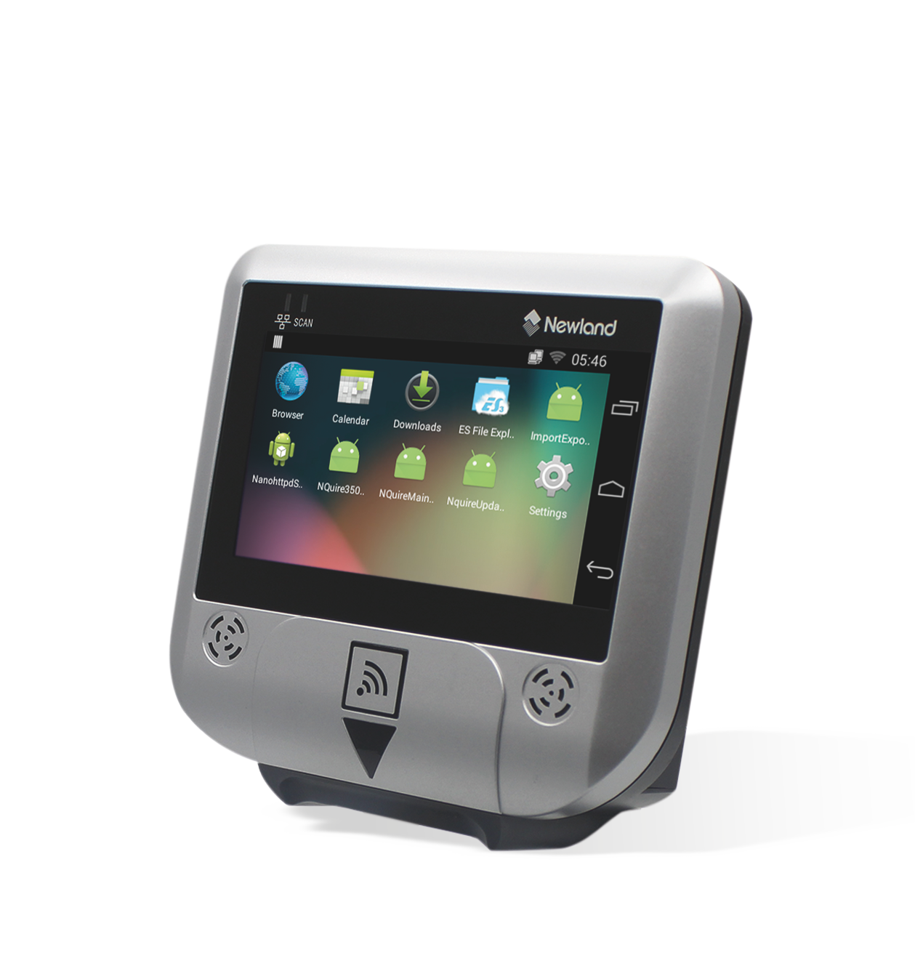
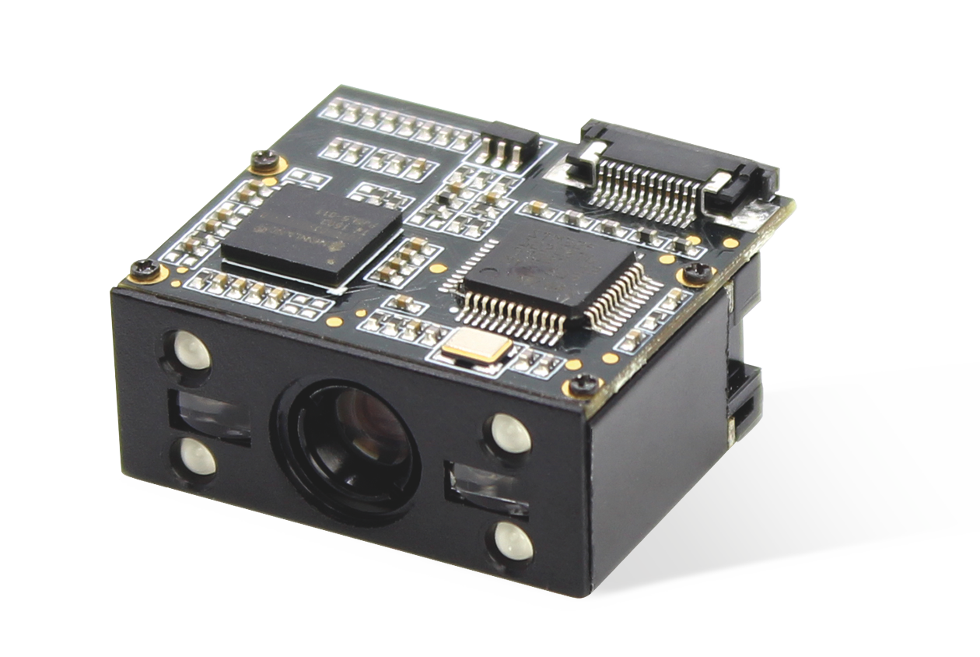
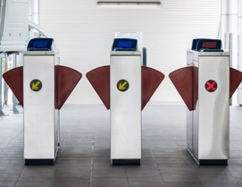
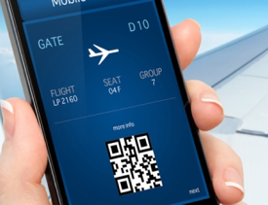



Auto-ID Products (AIDC)
OEM Scan Engines
Stationary
Scanners
Handheld
Scanners
Mobile Computers
Customer Information Terminals

Slide 9
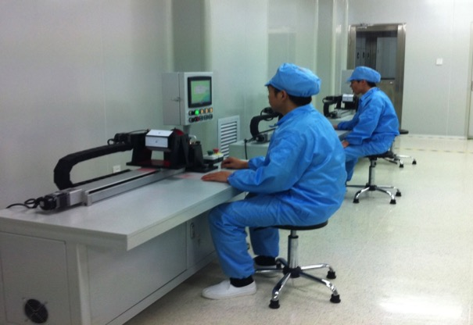
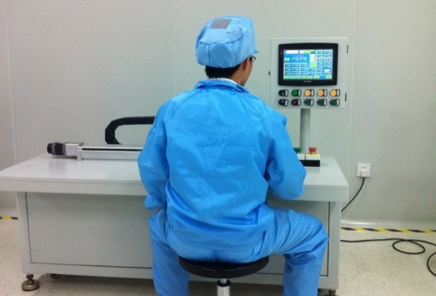
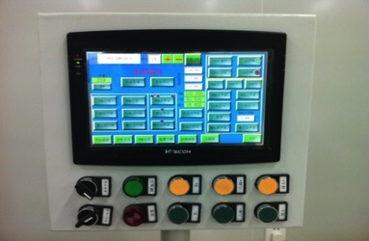
Manufacturing base: Xinyu Electronics Factory
Automated imager engine assembly line.
Annual capacity of more than
1 million imager engines.

Slide 10
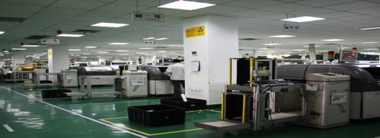
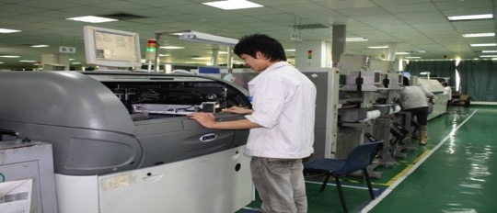
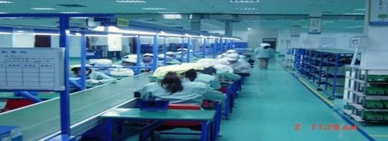
Manufacturing base: Xinyu Electronics Factory
8 SMT production lines
Monthly capacity 100K PCB, mainly used for Newland E-pos and Auto-ID.
Annual capacity - 1.2 million.
3 Peak furnace lines
Monthly Capacity - 300,000.
Annual capacity - 3.6 million.
Assembly site of 3000 m²
Maximum capacity of 15 lines and Annual capacity - 1 million.
Currently in use: 5 assembly lines, 300,000 sets per year.

Slide 11
Technology

Slide 12
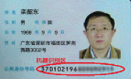


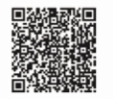

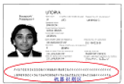





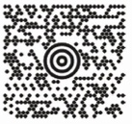
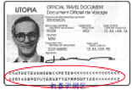


Reading capability
1D Symbologies
EAN-13 | EAN-8
UPC-A | UPC-E
Code 128 | AIM 128
UCC/EAN 128 | ISBT 128
Code 39 | Code 39 Extend
Code 93 | Code 11
Interleaved 2 of 5 | Matrix 2 of 5
IATA 2 of 5 | Industrial 2 of 5
Standard 2 of 5 | NEC 2 of 5 (COOP)
EAN-2 Addon | EAN-5 Addon
MSI-Plessey | UK-Plessey
Codebar | German Post
ITF-14 | ITF-6
RSS-14 | RSS Limited
RSS Expanded | Codablock-F
2D Symbologies
CS Code | DataMatrix
QR Code | PDF417
MicroPDF | Micro QR
 | Aztec
GM | Maxicode
Postal bar code | Composite Code
OCR

Slide 13
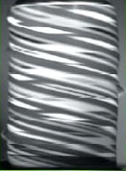
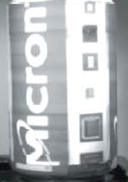
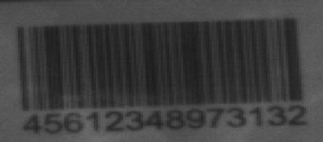

Imaging Processing Technology
High-speed moving image
capture technology
Anti-fouling treatment technology
Precision | Linear: 0,7 ppm PDF417: 1,1 ppm Matrix: 1,7ppm
Motion Tolerance | Linear Imager: Up to 100 cm/s Area Imager: Up to 550 cm/s

Slide 14
The world’s first 2D decode chip
Based on the two-dimension decode chip development, Newland gained 120 patents, of which 3 US patents. Meanwhile, 3 US patents and 5 European patents are in process.
Decoding quickly
Reduce the power consumption
Small size, suitable for OEM
Reduce the complexity of design
Independent intellectual property rights
Scanner
Others
Mobile
Computer
Mobile phone

Slide 15
OEM Scanning
Engines

Slide 16
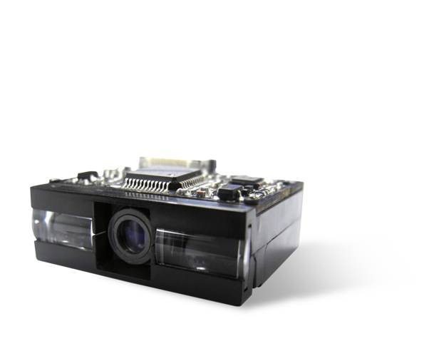
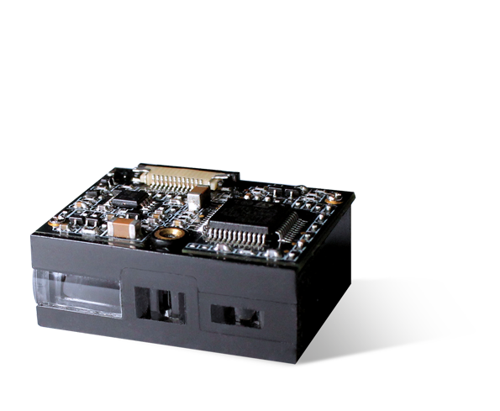
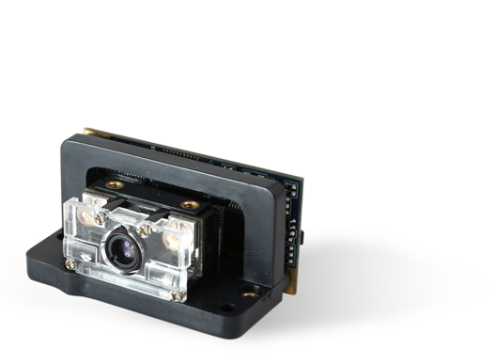
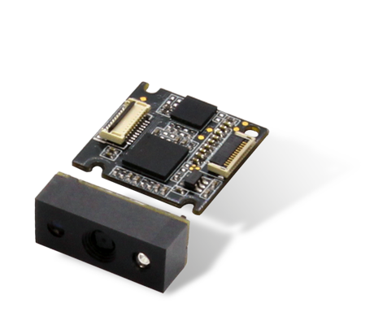
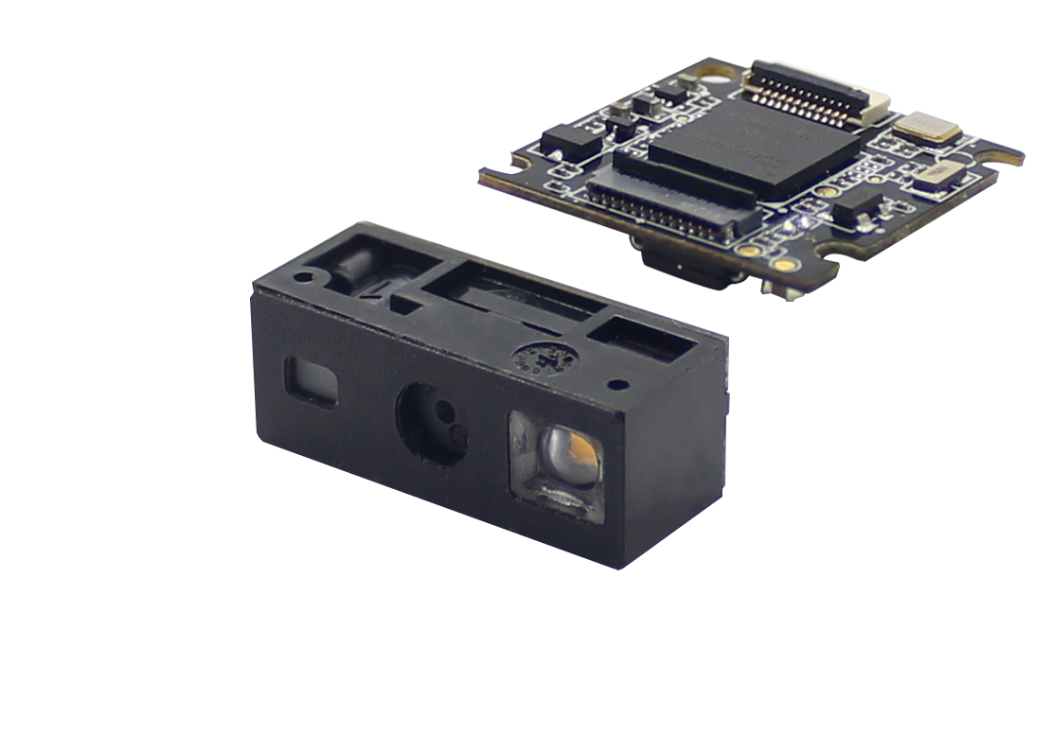
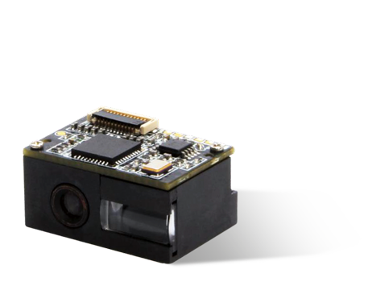
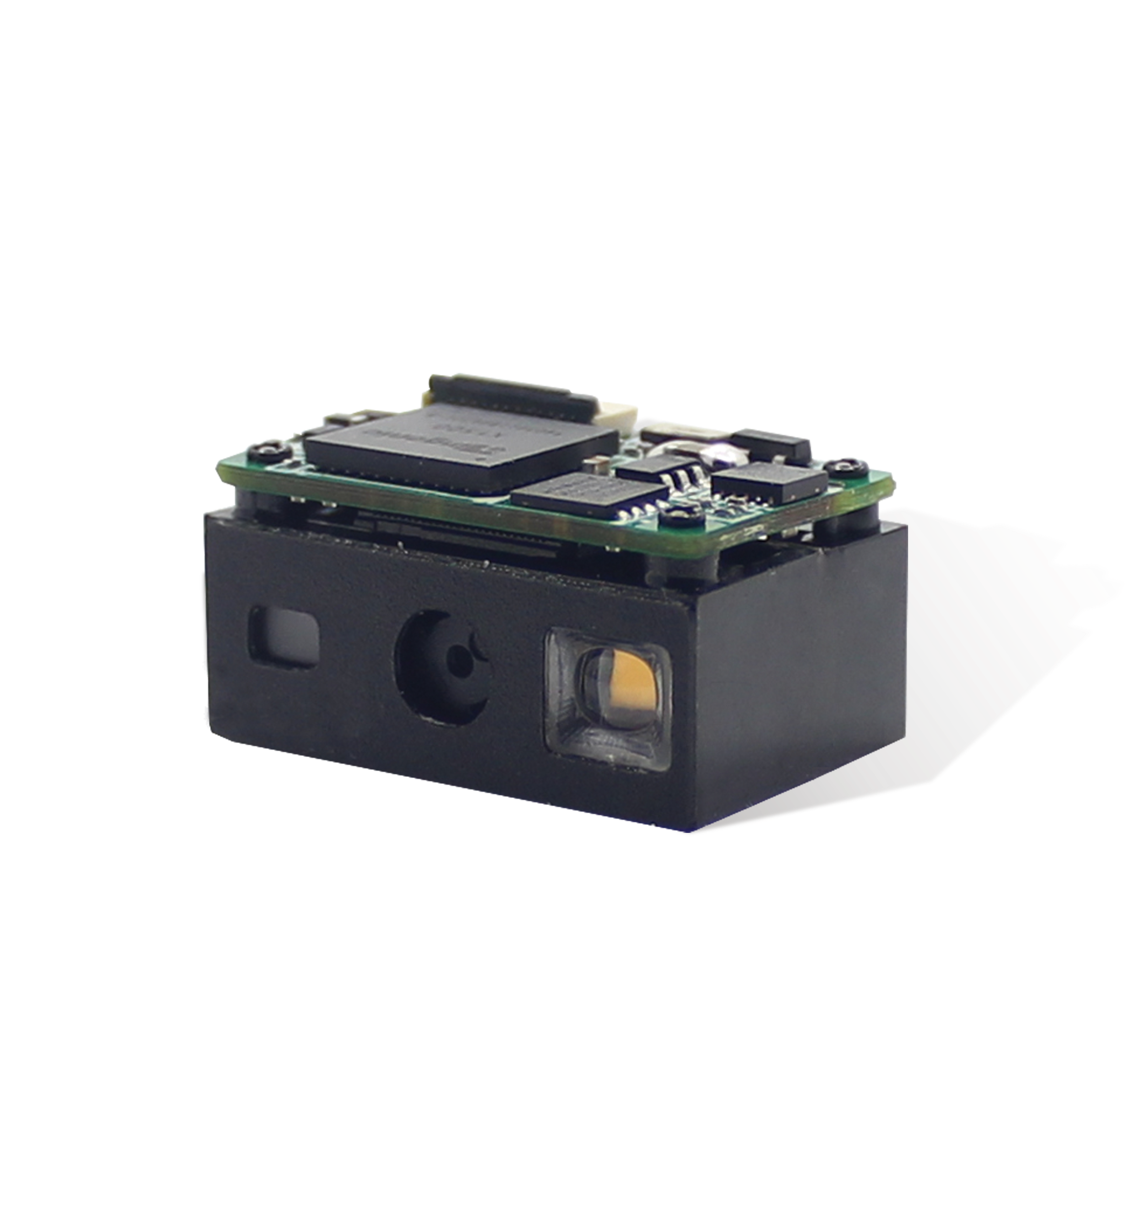
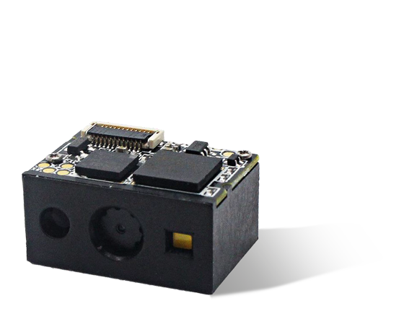
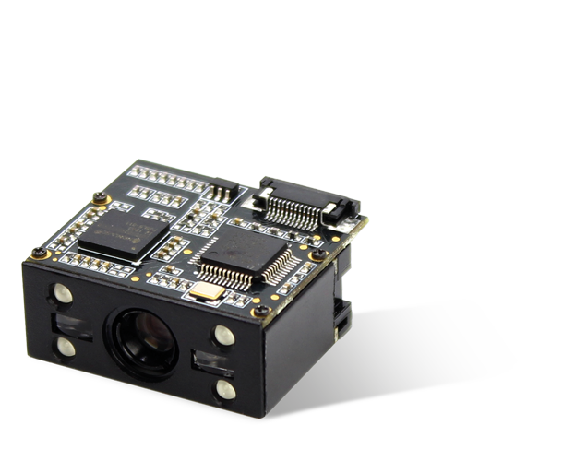
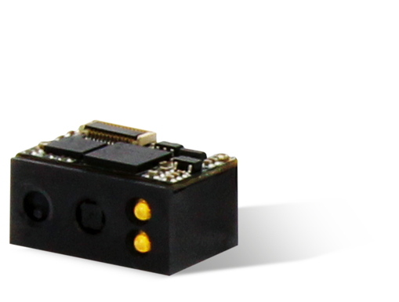
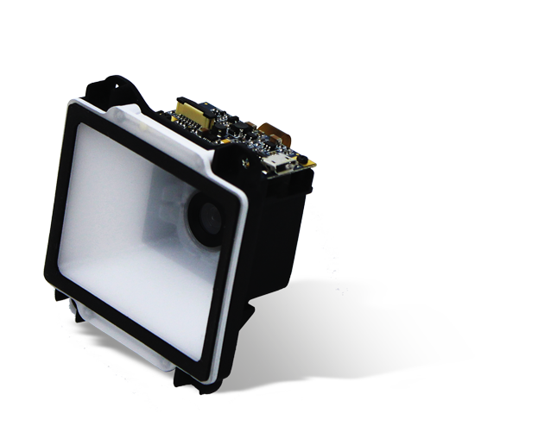
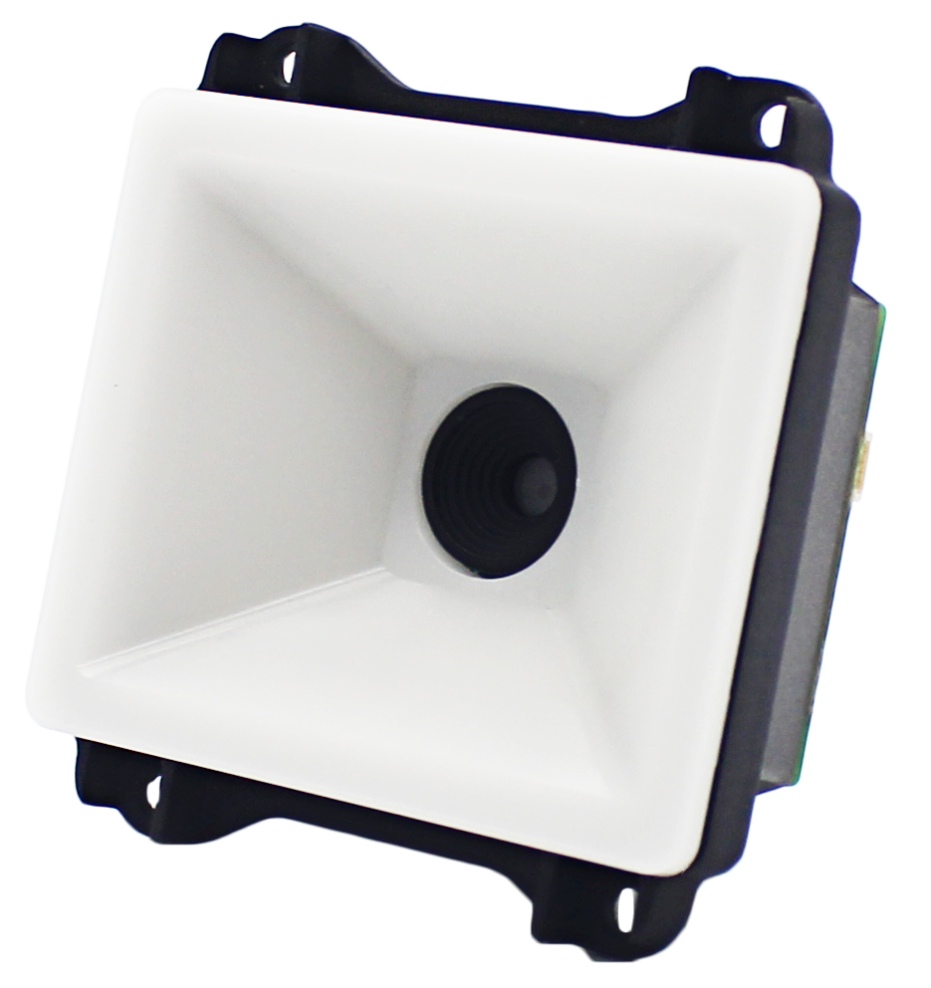
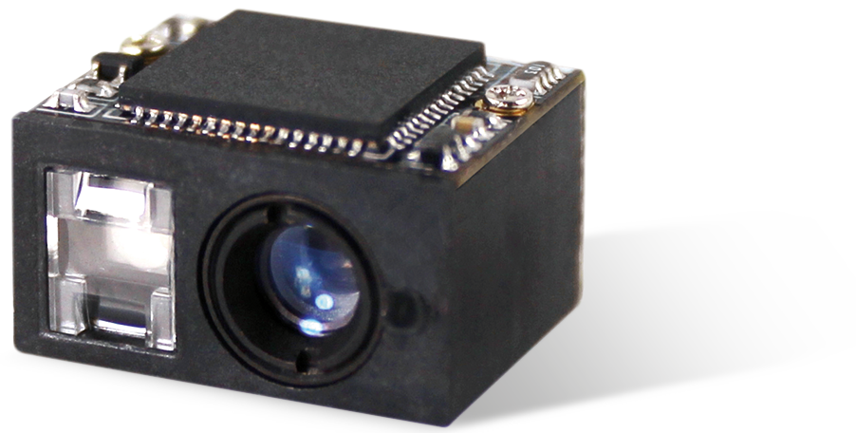
OEM Imager Modules
EM1300
EM1365-LD
EM1399-LD
EM2037-V4
EM2096
EM50-10/-20
EM3080-W
EM3085-M
EM3090
EM3296/3396
EM20M-37
EM20-80

Slide 17
Mobile Computers

Slide 18
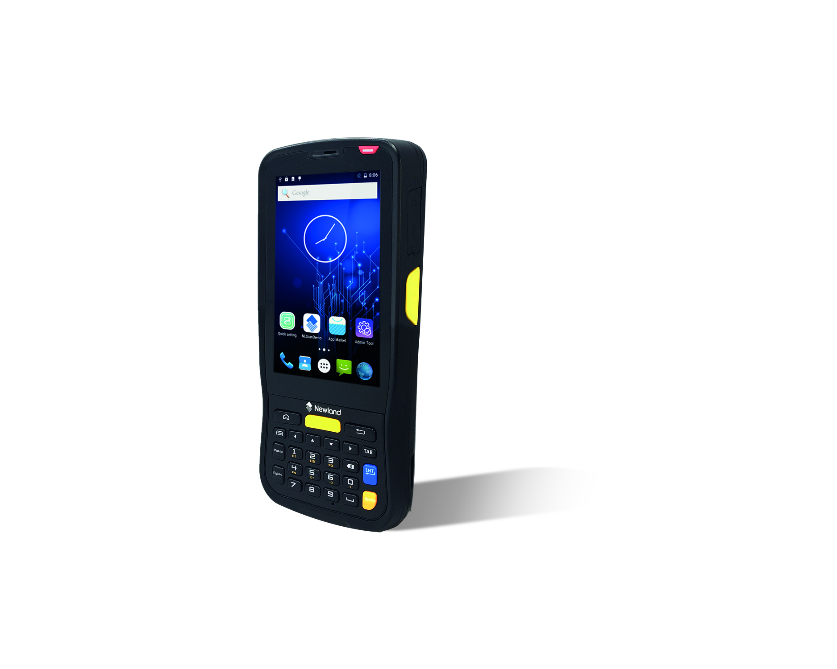
1D & 2D Android Mobile Computers - Retail
MT65 Beluga III
Retail Applications

Slide 19
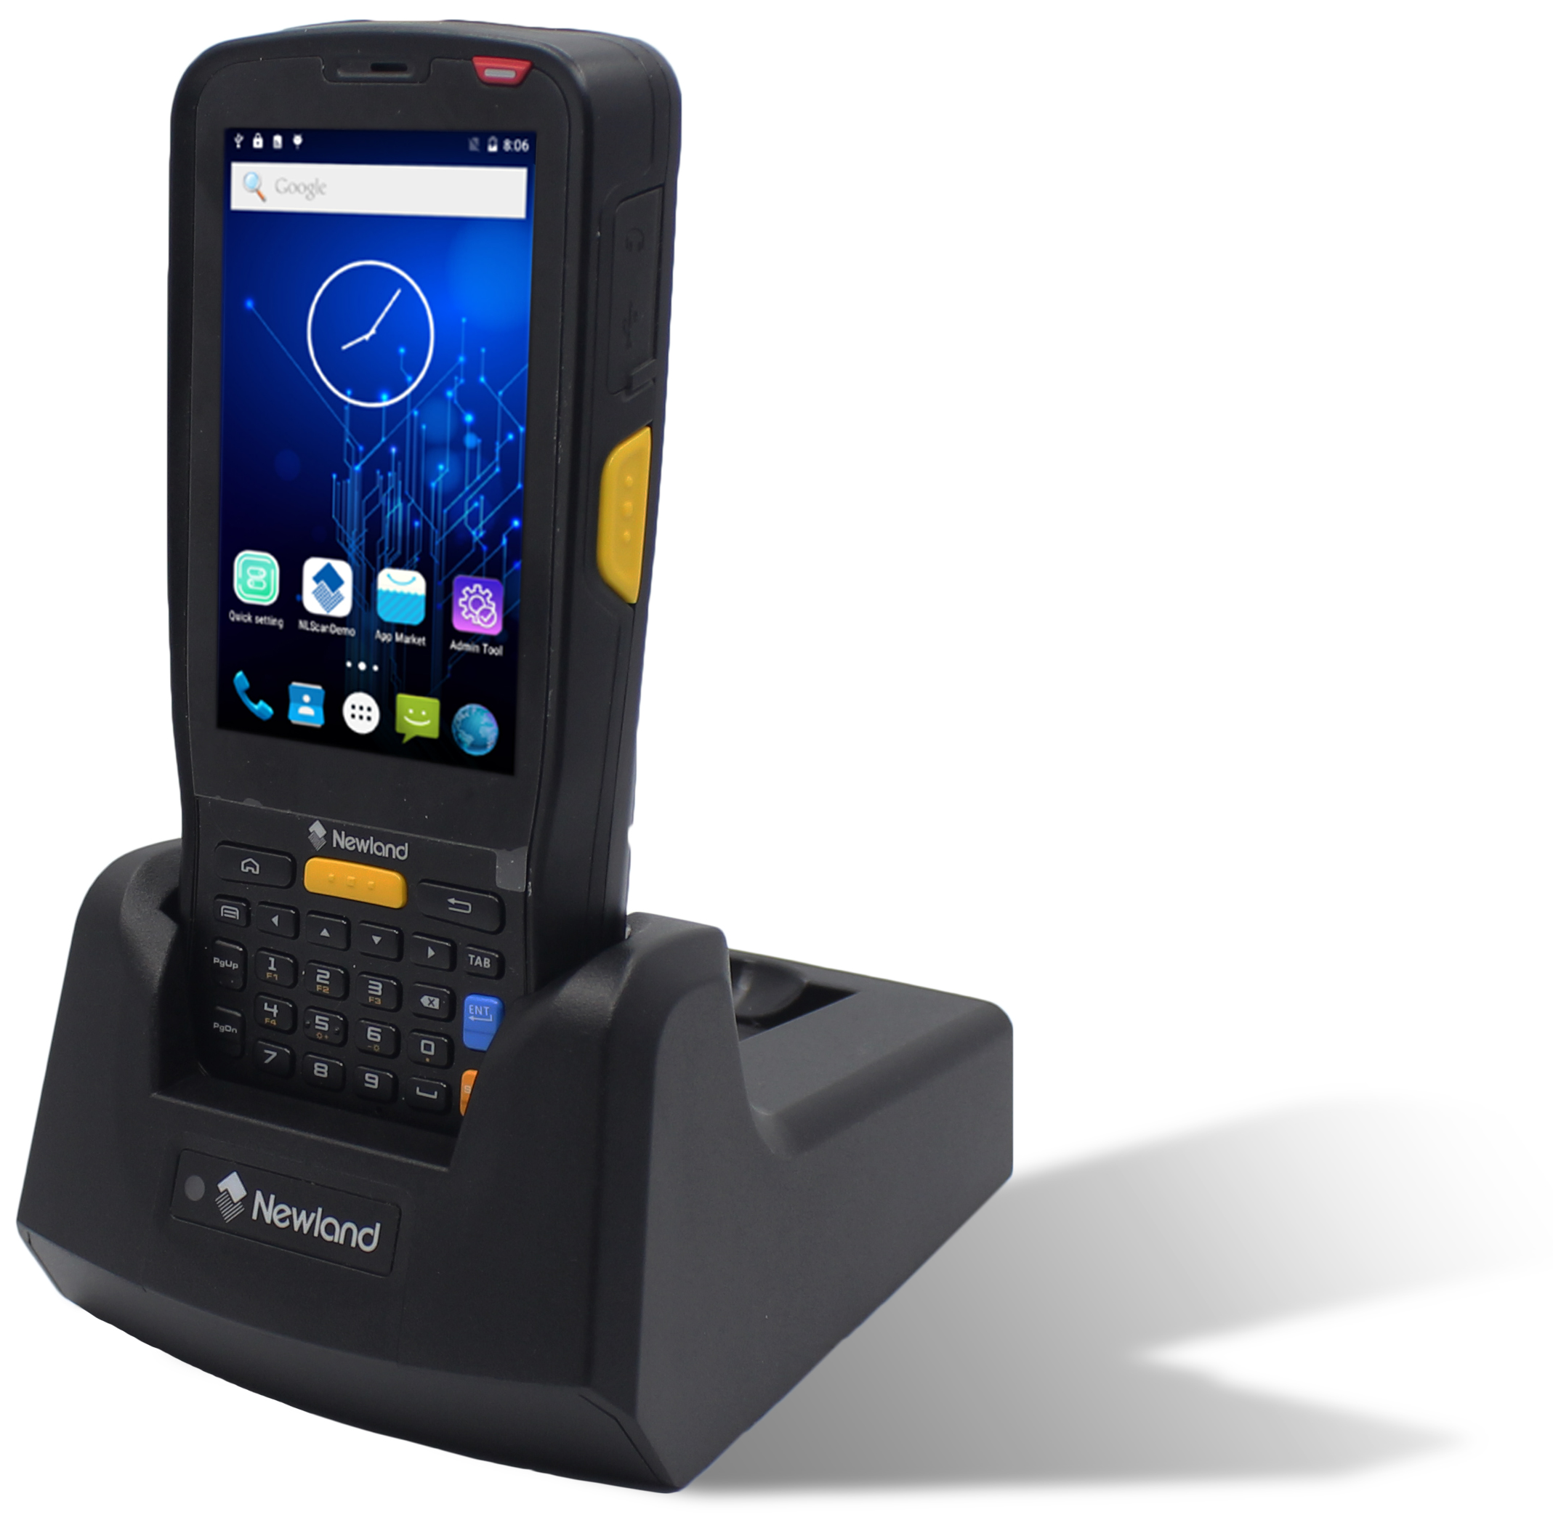
MT65 Beluga III – Android Mobile Computer
Megapixel barcode scanner.
Armed with Newland’s fifth generation of UIMG technology 2D megapixel engine, the MT65 Beluga III decodes even poor quality barcodes, such as wrinkled labels, with ease.
Heavily customizable Android OS.
The Android OS of the MT65 Beluga III ensures near endless application possibilities. It gives you the data security and admin tools you need for control and complete peace-of-mind.
Rugged construction.
MT65 Beluga III is sealed to IP65 standards for protection against dust and water and withstands 1.2m drops to concrete.

Slide 20
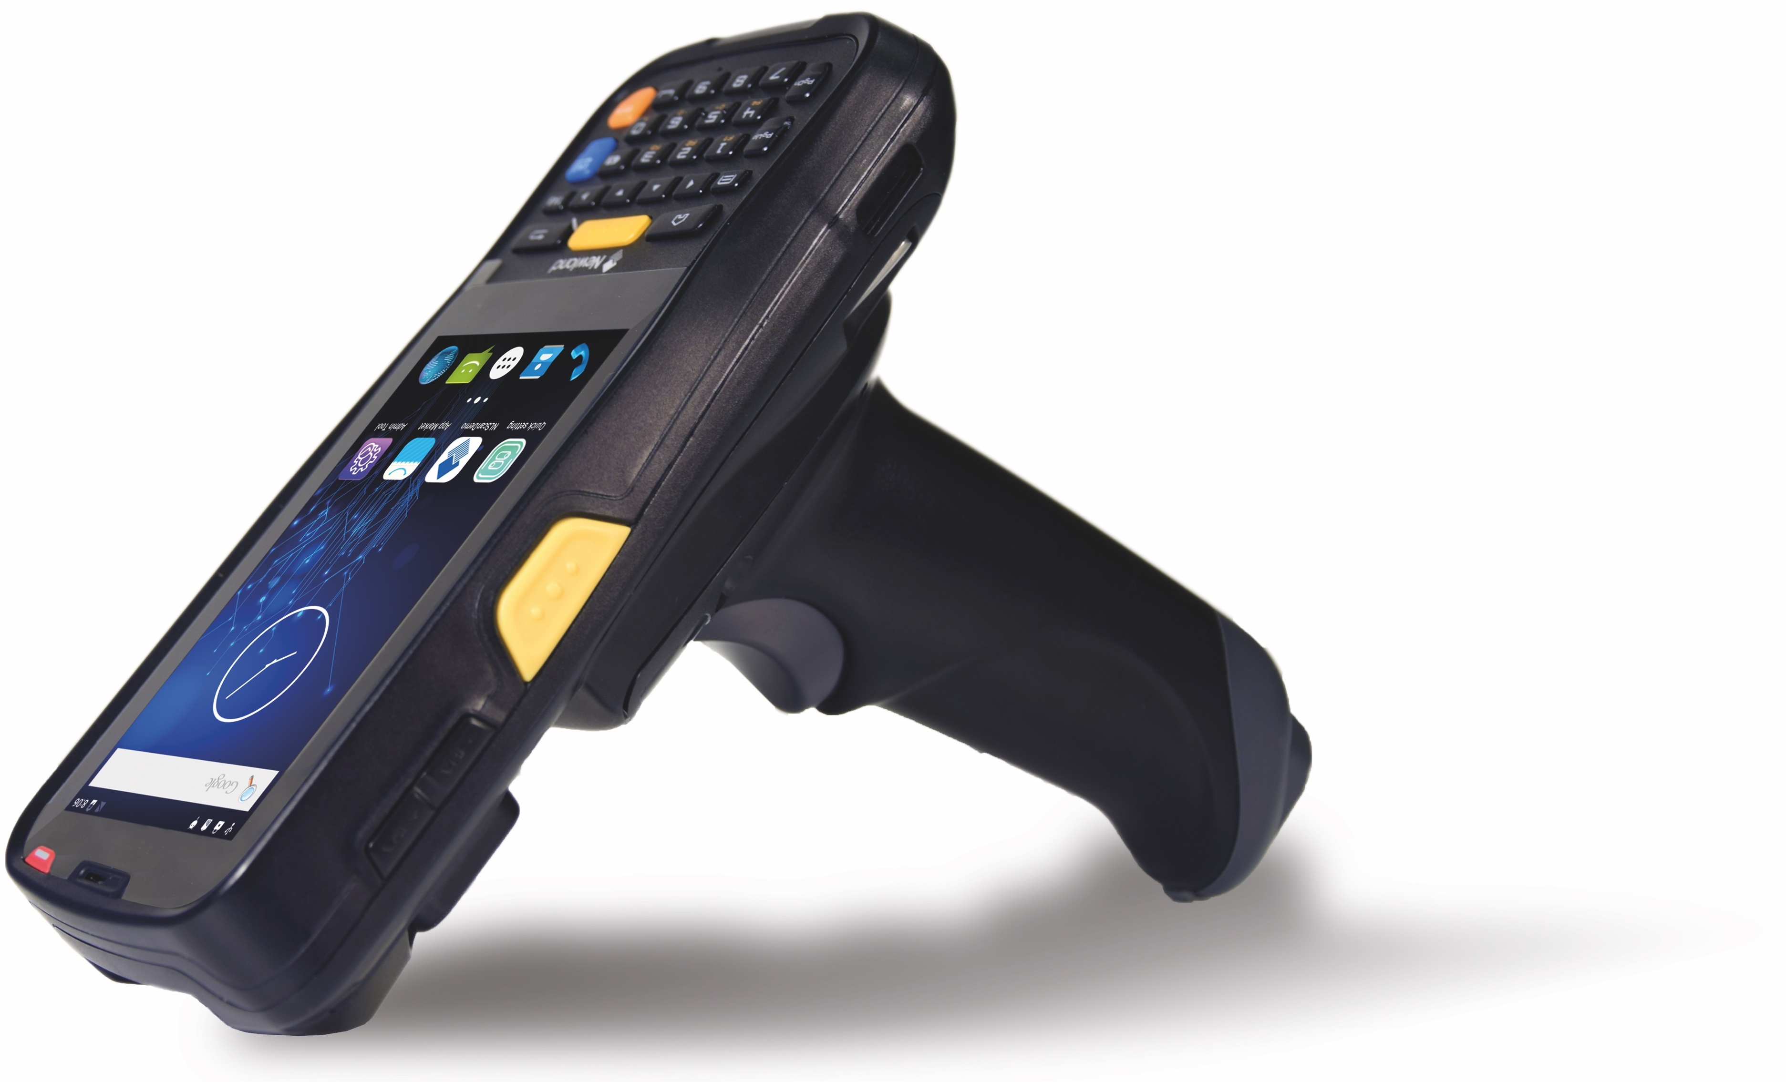
MT65 Beluga III – Android Mobile Computer
Extended battery life.
The MT65 Beluga III provides up to 10 hours of battery life, so it is sure to last a full shift for average applications. Is your application more intensive? A replaceable battery and charging cradle with extra battery slot ensure employees can easily switch it out and continue scanning.
Buckets MDM software included.
Each MT65 Beluga III includes Newland’s mobile device management software: Buckets. Buckets enables you to control all units in the field, allowing you to quickly push updates and changes, to send messages and to keep track of all devices from a single location.
Current models released.
MT6551-2W (without cradle)
MT6551-2W-C (with cradle)
Optional accessories: pistol grip and charging cradle.

Slide 21
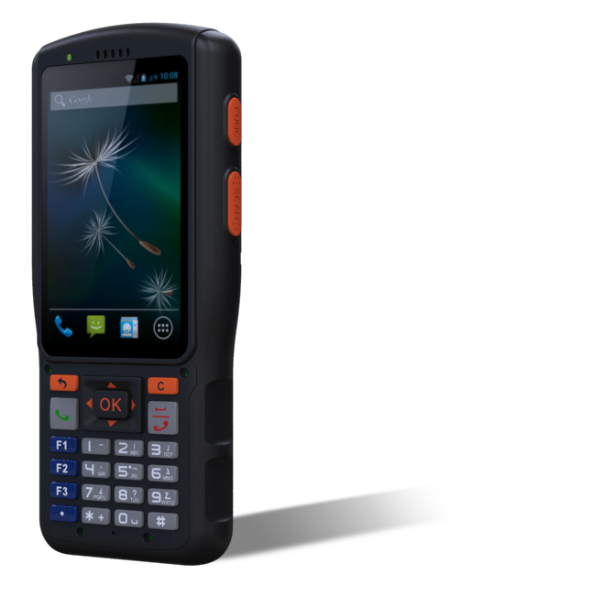
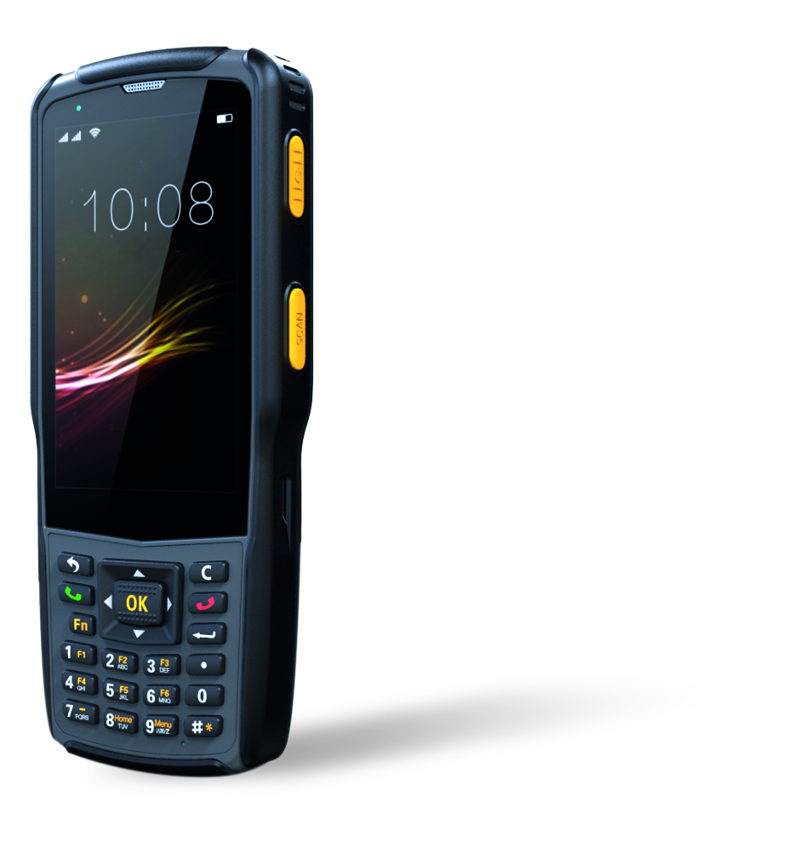
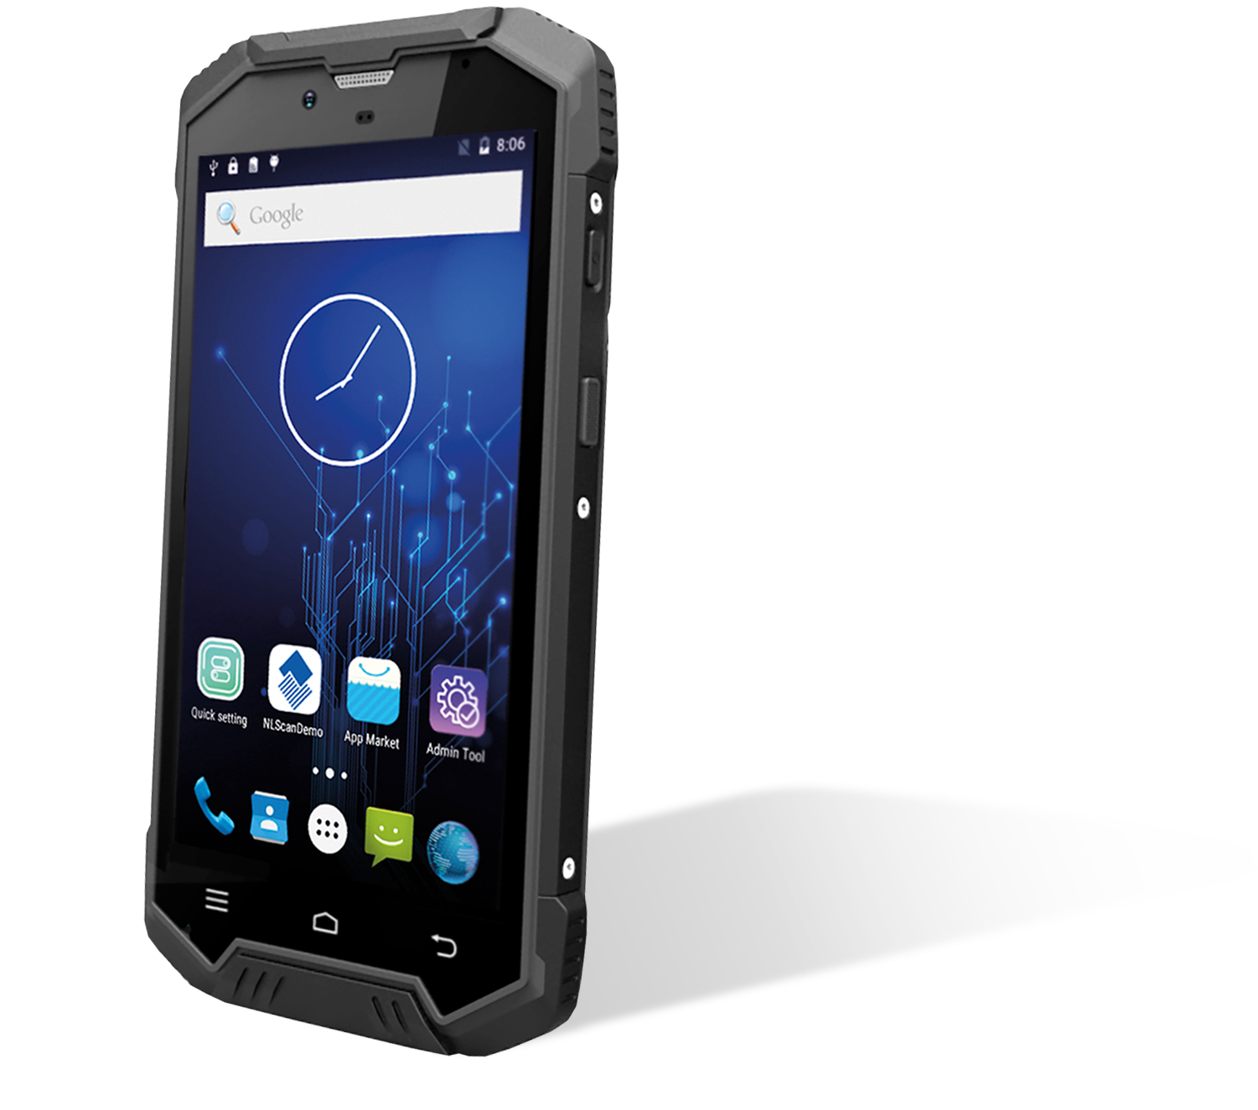
Android Mobile Computers - Logistics
New
N2S
N5S
N7000R-II
Logistics Applications

Slide 22
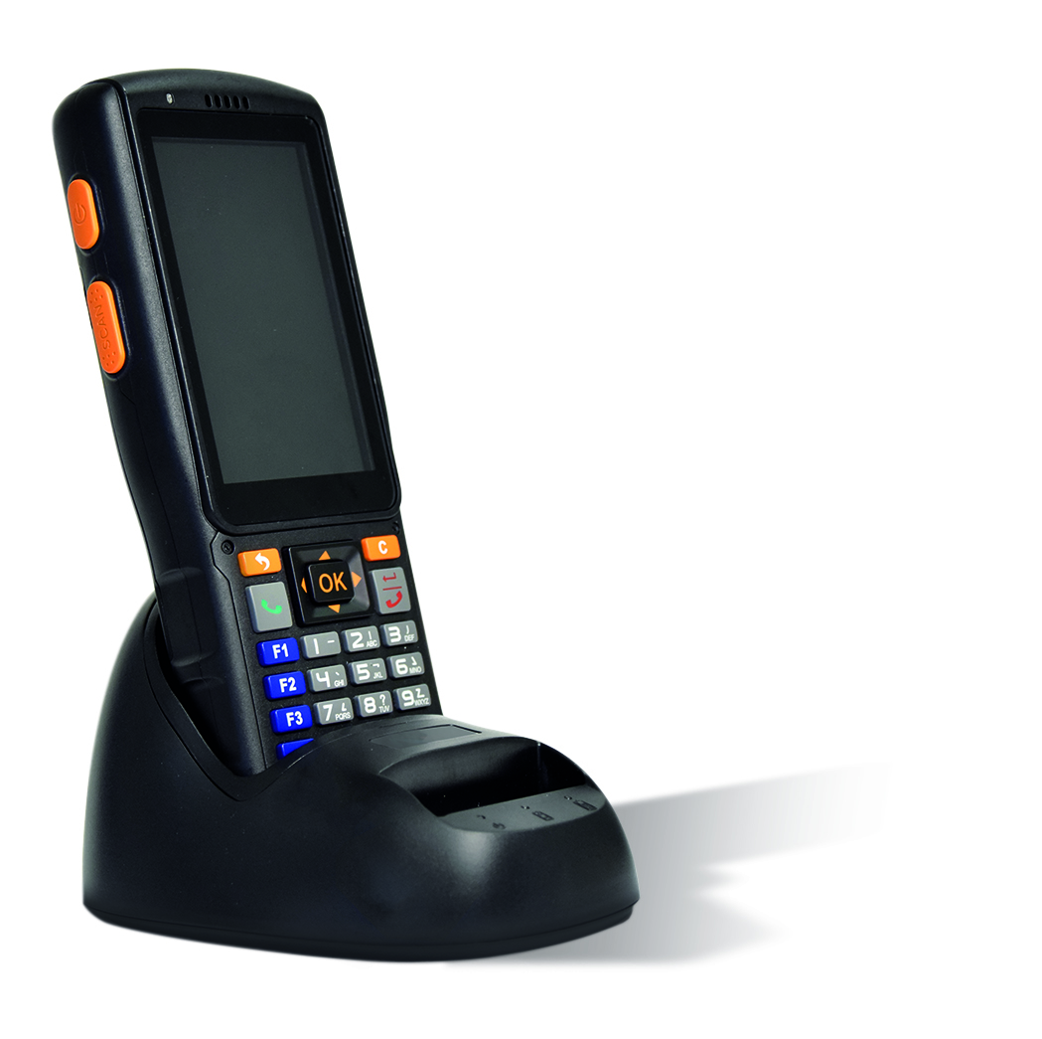
N2S – Android Mobile Computer
Powered by a Newland scanning module.
The N2S is armed with a high performance 1D/2D scanning module, ideal for day in and day out heavy scanning.
First time everytime barcode scanning.
The N2S has a 25 degree scan angle, making scanning easy and comfortable while reading the screen.
Built to withstand heavy use.
A durable design, reinforced by carefully selected materials, guarantees low maintenance costs even for use in harsh conditions.
High quality PCAP Touch.
The N2S supports both dry and moist hands, as well as gloved fingertip touch input. Ideal for use in severe conditions, such as rain, snow and dust.
Supplied with charging stand.

Slide 23
N5S – Android Mobile Computer
Advanced 1D/2D barcode scanning.
N5S is is armed with a high performance 1D/2D scanning module, ideal for day in and day out heavy scanning.
Powerful high-speed performance.
This smartphone PDA scanner runs on Android 7.0 OS and has a 1.45 GHz Quad Core CPU, which guarantees high performance with easy customization and development possibilities.
Flexible wireless connectivity options.
N5S supports 4G full network and N5S supports 3G network, WIFI 802.11 a/b/g/n (2.4Ghz / 5Ghz). Also, with the embedded NFC reader, you can use mobile payment & access control.
NEW

Slide 24
Symphone N5S – Android Mobile Computer
Built to handle all-day every day use.
With its ergonomic double material molding and IP65 industrial sealing, the device can work under extreme conditions. It supports both dry and moist hands, as well as gloved fingertip touch input.
With the convenience in mind.
For you comfort, the Symphone N5S is optimized for one-handed usability. The device has a 4 inches high resolution display with multi-points touch screen.

Slide 25
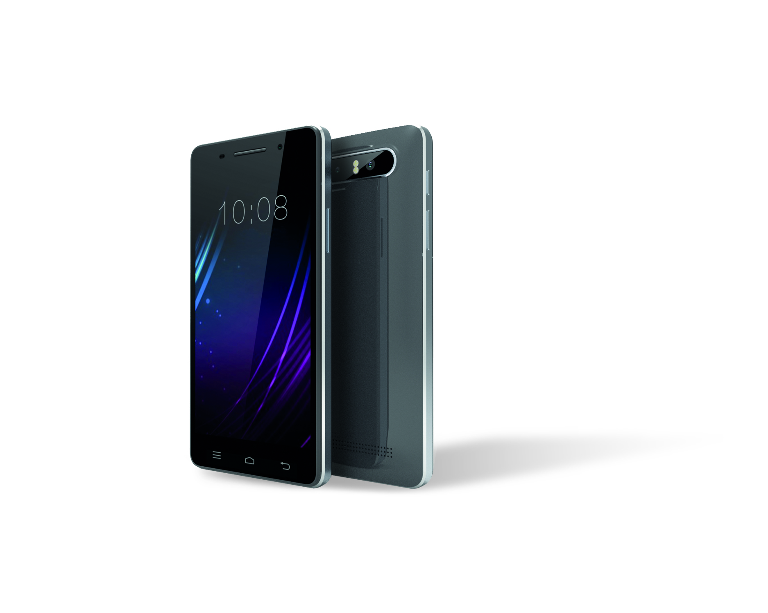


Android Mobile Computers - Enterprise
N5000
N7000
N7000R-II
MT90 Orca
Enterprise Applications

Slide 26

N5000 – Android Mobile Computer
Powered by a Newland scanning module.
The N5000 is armed with Newland’s smallest 2D scanning engine, allowing for seamless integration in the smartphone form factor.
First time everytime barcode scanning.
The N5000 comes with Newland’s patented barcode scanner technology, allowing for 1D and 2D scanning at a remarkably high speed. Laser aiming provides additional accuracy and control.
High quality display.
The device sports a 5.0” high definition display in daylight viewable color.
High quality PCAP Touch.
The N5000 supports both dry and moist hands, as well as gloved fingertip touch input.

Slide 27
N5000 – Android Mobile Computer
Effective in both light and dark conditions.
Automatically adjusted illumination guarantees an excellent scanning performance no matter what the lighting conditions are.
A choice of 3 detachable color caps.
Each product is supplied with a grey color cap. The detachable cover increases the ruggedness of the N5000.

Slide 28
Symphone N7000 – Android Mobile Computer
Contemporary design.
With the look and feel of an Android smartphone, the N7000 offers an intuitive scanning solution. Equipped with Newland’s smallest 2D scanning engine, the device combines enterprise-level performance with the familiarity of a consumer device.
First time everytime barcode scanning.
With a high-performance OEM engine that scans both 1D and 2D barcodes at a remarkable speed, the N7000 is sure to increase worker productivity. A bright laser aimer provides additional accuracy and control.
Versatile Operating System.
Running on Android 5.1, the N7000 can be customized to suit your company and application. The OS makes it easy to integrate it with existing and future IT structures.

Slide 29


N7000 – Android Mobile Computer
Powerful performance.
The N7000 has a Quad Core 1.3GHz CPU that ensures robust application performance. Its 5 inch display has a multi-points touch screen and works with a gloved finger, stylus or when wet.
Comprehensively connected.
Equipped with dual band Wi-Fi 802.11 a/b/g/n (dual
band 2.4 Ghz/5Ghz) and supporting a 4G network, the N7000 can stay connected both indoors and in the field. A dual SIM option allows you to use the most suitable provider available wherever you go.
Supplied with a protective cover.

Slide 30
N7000R-II – Android Mobile Computer
Industrial smartphone design.
The N7000R-ll runs on Android 7.0 and contains Newland’s smallest 2D scanning engine, allowing for seamless integration in the smartphone form factor.
Powerful scanning performance.
Scanning of 1D/2D barcodes. The N7000R-ll has a high performance engine that ensures speed, and a bright laser aimer that makes scanning accurate and simple.
Optimal connectivity.
Staying connected while in the field is no problem with the N7000R-ll. It supports a 4G network and dual band Wi-Fi, 802.11 a/b/g/n (dual band 2.4 Ghz/5Ghz). The device also has a dual SIM option, allowing you to use the most suitable provider available wherever you go.

Slide 31

N7000R-II – Android Mobile Computer
Large memory.
With 3GB RAM and 32GB ROM, you will be able to upload all the necessary applications to fulfil everyday needs.
Built to survive demanding environments.
No matter the environment, the N7000R-ll offers you a reliable solution. With IP67 sealing, it is highly protected from dust and moisture. The device is water-proof at depths of up to 1.5m and can operate in temperatures from -20°C to 55°C.
Crystal clear display.
The N7000R-ll has a 5 inch 720P high quality display, with a capacitive touch screen that supports gloved fingertip input. Despite its size, the design of the device allows you to comfortably work with one hand.

Slide 32
MT90 Orca – Android Mobile Computer
Full touch screen mobile computer.
The MT90 Orca is an Android 7.0 mobile computer that packs all of the latest hardware in a modern and user-friendly design. It is a light and durable device with a 5” capacitive touch screen. Equipped with a familiar user interface and the exterior of a consumer phone, the MT90 Orca is easy to set up and use right out of the box.
Snappy 1D and 2D barcode scanning.
Developed for quick and efficient barcode scanning, the MT90 Orca ensures maximum productivity. Its scan engine is built in at the top of the device and can be triggered with a virtual button on the screen or a physical button on the side of the device for easy point-and-shoot scanning.
Reliable all day use.
The MT90 Orca has a 3.8V 4500 mAh battery that allows you to use the device all day without problem. Additionally, the battery is replaceable, allowing you to use a spare battery if needed.

Slide 33

MT90 Orca – Android Mobile Computer
Business-class durability.
The MT90 is built to withstand dusty environments and inevitable bumps and drops. It has a rating of IP65 and has been drop tested up to 1.5m, ensuring longer and more reliable use.
Buckets: Newland’s MDM software.
Buckets allows you to monitor and manage all devices in the field from one central administrated location. This MDM software enables you to distribute your APK’s, change OS version or settings and many other functions. Buckets MDM software is pre-installed on the MT90 Orca and includes up to 7 years license-free use.
Accessories that match your operations.
A wide range of accessories ensure the MT90 Orca suits your application and operating environment perfectly.
Included: single slot charging & communication (USB) cradle, rubber boot, hand strap and wrist lanyard.
Optional: pistol grip, holster and Ethernet cradle.

Slide 34




Mobile Computers positioning
MT90 Orca
High end
N7000R-II
N5S
MT65
Beluga III
N7000
PT60 Narvalo
Entry level
N2S
N5000
PT30 Omura
Basic
Full features

Slide 35
Success
Stories

Slide 36








Succes stories: retail
Where to use
Warehouses & distribution centers
In-store demo management
Why Newland
Proved outstanding performance of reading 1D/2D barcodes.
Reliable wireless connectivity base on cutting-edge wireless technology
Membership management
Used at
cash register
Distributor
management
2.000 PCS
BS80 Scanners
2.500 PCS (ongoing)
BS80 Scanners
2.000 PCS
PT980

Slide 37


Succes stories: retail
Amount of products sold: 5.500 PCS.
Application.
PayBack is a loyalty program. A customer collects payback-Points for every sale. A customer can easily collect Loyalty Points via a QR-Code generated by Payback App as well as pay goods without cash.
Why FM3050?
dm Drogeriemarkt choses FM3051 due to the fact, that the reading performance from smartphone was excellent at the offered price level. After a year in field we see less respectively only a small amount of RMAs.
FM3051

Slide 38











Succes stories: retail
More than 10.000 PCS price checkers.
NQuire
200 series

Slide 39


Succes stories: retail
Amount of products sold: about 500 PCS.
Goal of the project for Foxy Group / Bison:
Bison wanted to use our NQuire1000 as an information screen for their customers in combination with Foxy Groups software, Foxy made the Bison glue advisor this way, where end-customers can find the right glue for the right purpose. If the unit is not used it will display commercials.
NQuire
1000
Manta

Slide 40


Succes stories: medical & healthcare
Newland took 60% + of medical and healthcare
market in China
200.000 PCS handheld scanners installed in China
Over 15.000 PCS MT65 Android Mobile Computers used in pharmacy
More than 130.00 PCS 2D hand scanners in pharmacy, hospital, dentist in Turkey and Germany
More than 10.000 PCS used in medial machine,
blood analysis, kidney dialysis through EMEA
Vaccine supervision – Hospitals and care centers
Drug supervision –
Drug stores
200.000+ PCS
Handheld Scanners
15.000+ PCS
Mobile Computers

Slide 41






Succes stories: logistics
From 2014 to 2015, Newland became major supplier for mobile devices and over 60,000 PCS MT65 are now used in pickup and delivery application in China Post.
Various express
logistic companies
Pick-up
& Delivery
Over 100.000 PCS in use of our
N2S and N5S Android Mobile Computers
60.000 PCS
Mobile Computers

Slide 42




Succes stories: embedded systems
We are in
Mobile devices
such as Mobile Computing, EFT
POS
Lottery & gaming machines, kiosks, ticket machines, Smart Locker and more
2D engines into
Sports Lottery machine.
DATECS mobile
phone backpack
HP tablet
backpack
HILTI driller with an integrated 2D scan engine
Took over 80%
market share.
100.000 PCS
OEM Scan engines
50.000 PCS
OEM Scan engines
7.000-10.000 PCS
a year - EM3080

Slide 43











Succes stories: online to offline
We are in
Barcode payment
E-voucher management
Membership card
Membership
management
Toll gate
payment
Banking
payment
E-voucher
EEP POS
application
POS
application

Slide 44


Succes stories: O2O - Alipay
Newland is a strategic partner of Alipay (subsidiary of Alibaba) and WeChat (Subsidiary of Tencent). The application AliPay has 750 million installations, in China.
In the past 2 years, over 250,000 units of Newland scanners and 300,000 units of scan engines are deployed in industries like retail and hospitality and membership management.
Where to use
Retail stores, pharmacy, restaurants, hotels,
gas stations, toll gates and more
Why Newland
Willing to invest together with customer for
the solution design, new application testing and customized product design
Good performance reading barcode on paper
and screen
Supply chain and finance capability
– ships 200.000+ PCS in 1 month

Slide 45

Succes stories: O2O – Yoyo Wallet
Amount of products sold: 4.000 PCS.
Goal of the project:
Deliver fast scanning of codes presented on customer’s phones
as part of a vouching and cashless payment application.
What they were looking for and how we helped:
Connected relationship between manufacturer and themselves
Be flexible in customizing product design
More communication between scanner manufacturer and the company creating their cases/mounts (ergonomic Solutions)
Centralize purchasing of both the scanner and mounts with the ability to upscale rapidly.
Most important to have a product with excellent scanning performance
FM3050

Slide 46

Succes stories: O2O – Smart delivery lockers
Newland supplied more than 50.000 barcode scan engines
and embedded scanners to smart locker manufacturers.
With rapid expansion of e-commerce and O2O business, the smart lockers is booming. Smart delivery lockers are equipped with a barcode scanner that enables the courier to quickly input tracking numbers by scanning the barcode. For the receiver, they can pick up the parcel by scanning a QR code in a mobile phone app to
finish ID validation.

Slide 47
Thank you for your attention

